Slide 1
Welcome to SPEECH & DEBATE!
2016-2017

Slide 2
Miss Renee Luedders Room D220
Miss Luedders
Miss L
**I WILL NOT ANSWER TO “Miss!!” I’m going to work to learn your names as soon as possible, I would appreciate it if you’d learn mine! ☺ **

Slide 3
A little about me! (your teacher)
4TH year at ACHS
English 12, Speech & Debate, Play Writing & Directing
Have a 2nd job as an embryologist at an infertility clinic
You will get EXTRA CREDIT for participating in some way or going to go see any of ACHS’ play productions or outside theatre. ANY QUESTIONS ABOUT ME??

Slide 4
Classroom website:
www.Rlueddersachs.weebly.com
What’s on it?? - School information - Links to infinite campus/ grades - Class worksheets, rubrics, PowerPoints - Book recommendations - Background information on me (your teacher) - Contact information for me (again… your teacher)

Slide 5
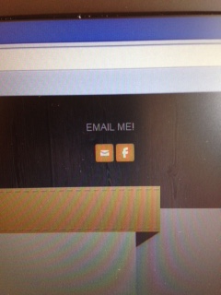
If you are absent:
Go to the website to review lessons that you missed. They will be posted daily
If you have questions about it, email me
You need to be prepared the next day you come to class- DO NOT WAIT to check what you missed

Slide 6
Classroom rules

Slide 7
No eating in class
- If you are caught eating, you will need to serve lunch detention with me - You can either come in that day or the next day. After then, you will be referred to the deans for a more serious punishment.

Slide 8
NO CELLPHONES or EARPHONES ALLOWED
- Your phone needs to be in your backpack, out of sight, not sitting on your desk or in your lap. - If you are caught using your phone, I will take it and keep it until the end of the day. (NOT END OF CLASS) -If you are caught a 2nd time, your phone will go to the deans - During work time, I will play music if the class decides it’s easier for them to work with music on.

Slide 9
BE ON TIME TO CLASS
- I will close my door as soon as the bell rings - If you are late, you will need to go down to get a pass

Slide 10
PLEASE DO NOT TALK WHEN I’M TALKING OR YOUR CLASSMATES ARE TALKING
- I love having debates and conversations in class, but please remember to be respectful to me and your peers at all times - If you are constantly being disruptive and inconsiderate, you will be asked to leave and sit in the hall

Slide 11
QUESTIONS SO FAR?

Slide 12
Where do I find things in the classroom??

Slide 13
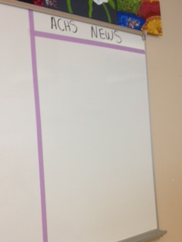
Where do I find things in the classroom??
NEWS HAPPENING AROUND ACHS

Slide 14
Where do I find things in the classroom??
VOCABULARY FOR THE UNIT

Slide 15
Where do I find things in the classroom??
WHERE TO GO FOR A FIREDRILL **You need to check in with me ASAP or I will assume you are burning to death**

Slide 16
Where do I find things in the classroom??
INFORMATION FOR YOUR CLASS

Slide 17
Where do I find things in the classroom??
INBOX- WHERE TO TURN EVERYTHING IN

Slide 18
Where do I find things in the classroom??
NO NAME PAPERS

Slide 19
Where do I find things in the classroom??
PAPERS THAT ARE GRADED AND READY TO BE RETURNED BACK TO YOU

Slide 20
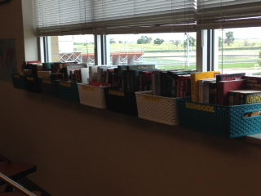
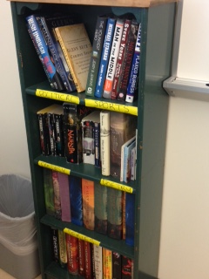
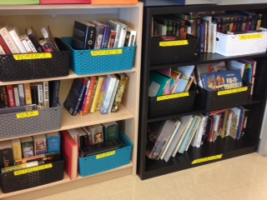
Where do I find things in the classroom??
INDEPENDENT NOVELS THAT YOU CAN BORROW

Slide 21
QUESTIONS SO FAR?

Slide 22
What needs to happen when I arrive to class
Look at the class board under “what you need”
Get everything out that you need BEFORE THE BELL RINGS
If you need worksheets, they will be on the front table ready for you to pick up. - Do this BEFORE you head to your seats
Put your backpacks under your desk- the only things that are on your desk are the items you need for class that day

Slide 23
What else is on the class board??
WARM-UP INFORMATION - You are expected to start on the warm up right when the bell rings
WHAT YOU NEED FOR THE DAY - We already went over this
DAILY PLAN - I will note everything that we will work on for the day
DAILY LEARNING TARGETS - These are the specific skills we will work on for the day

Slide 24
Grading Scale
I will us a 4 point scale for all assignments 4- A 3- B 2- C 1- D 0- F M- Missing, I did not receive the assignment
50%- Assessments
30%- Homework/Classwork
20%- Midterm/ Final

Slide 25
Late assignments/ Missing work
Late Assignments: - I will accept assignments late, BUT they will be last for me to grade and your grade might not reflect it for a while ADVICE- JUST TURN THINGS IN ON TIME! ☺
Missing work: - You can turn missing work in until the end of the quarter unless I say other wise, BUT AGAIN, it will be graded last

Slide 26
QUESTIONS SO FAR?

Slide 27
What do I need for this class??
By NEXT CLASS! -Spiral/ Writer’s Notebook **You will be doing ALL of your writing in this, NO loose paper will be accepted **

Slide 28
What do I need for this class??
For NEXT CLASS! - Highlighters - Pens/ Pencils
**We will be doing a lot of annotating in this class, and highlighters help!**
**You need to have something to write with every day**

Slide 29
SYLLABUS INFORMATION
You need to take the syllabus home to show to your parents

Slide 30
SYLLABUS INFORMATION
Your parent will need to: - Sign the form saying that they understand everything that is expected - Put their phone # in case I need to contact them - Put their email address in case I need to contact them
**If any of these areas are blank, I will not accept the form.**

Slide 31
SYLLABUS INFORMATION
I need to have the syllabus’ back by this MONDAY!

Slide 32
ANY FINAL QUESTIONS?

