Slide 1
Debate Style #3
Lincoln-Douglas Debate

Slide 2
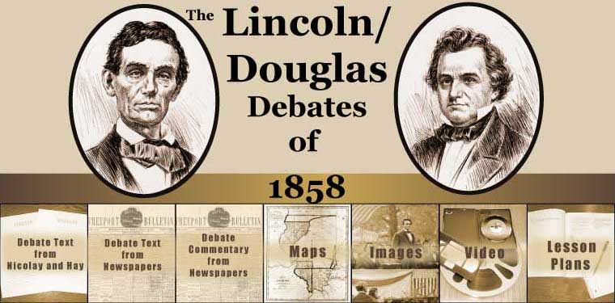
What is a Lincoln-Douglas Debate?
It’s better known now as a PRESIDENTIAL DEBATE
Named after the first presidential debates of Abraham Lincoln & Stephen Douglas
Includes 1 Moderator & 2 Candidates

Slide 3
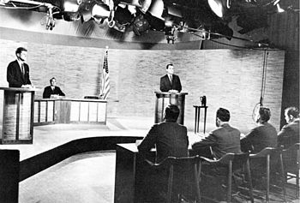
Lincoln-Douglas Debates are usually held towards the end of an election cycle
Feature 2 candidates from each party that answer questions about their position
Since 1960, these debates have been televised and are typically viewed by 67 million voting Americans

Slide 4
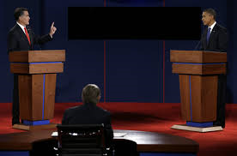
Format
The 2 candidates stand in front of the audience behind podiums.
The moderator sits in front of them at a table, with the audience behind them.
Depending on the agreement, just the moderator can ask questions, or the candidates can address questions from the audience as well.
A coin toss determines who speaks/answers the question first

Slide 5
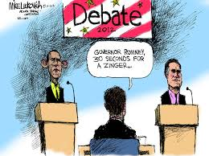
Timing
After being asked a question, the candidate has 2 mins to answer
After the 2 mins, the opposing candidate has 1 min to rebuttal
If the discussion is going well, the moderator can give each candidate an additional 30 seconds to address the topic.

Slide 6
HOW WILL OUR DEBATE GO?

Slide 7
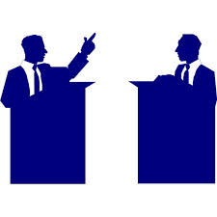
Dates of Debates:
Friday, December 9th

Slide 8
After the moderator has finished their questions, the discussion will be opened up to the class

Slide 9
QUESTIONS?

