Slide 1
HOW TO PREPARE AN OPENING & CLOSING STATEMENT FOR YOUR DEBATE

Slide 2
HOW DO I START?
Your first line should state exactly what your side is arguing
Examples: “ Euthanasia should be illegal” “Euthanasia should not be illegal”

Slide 3
THE REST OF THE STATEMENT…
The rest of the statement needs to SUMMARIZE in PERSUASIVE LANGUAGE why your position is the strongest.
Use “we” instead of “I”… you and your team are in this TOGETHER!

Slide 4
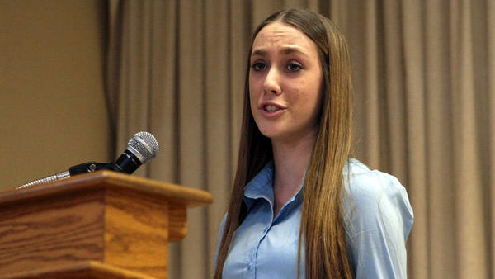
You don’t want to give too many details, but you should explain the strongest points you want to make, or that your team has made during the debate. You should have at least 3 solid points to make, but you can have more.

Slide 5
.
Think of this opening & closing statement like a story you are telling about why your argument is the most convincing.
Consider using QUOTES that you think are emotionally powerful. You MUST appeal to people’s sense of REASON and EMOTION.

Slide 6
HOW LONG SHOULD IT BE?
The opening & closing statement will probably be 1 page long (typed)
It should take about 2 minutes to read.

Slide 7
PRESENTATION OF THE OPENING & CLOSING STATEMENT
Speak slowly, clearly, loudly.
Do NOT stumble over your words.
You should know the writing well enough to feel CONFIDENT and COMFORTBALE as you present your position.

Slide 8
QUESTIONS?

