Slide 1
Debate #1
Talk Show

Slide 2
Your first debate of the semester will be in a TALK SHOW format

Slide 3
What are some of the things that you think about/ associate with a TALK SHOW?

Slide 4
PROPERTIES OF A TALK SHOW DEBATE:
Debates happen in an “in your face” sort of way
Very impassioned
Provides opportunities for everyone to talk as much as they want
Are more informal than most other types of debates
Allows you to go beyond two-sides & allow for more in-depth conversations
There is generally a MODERATER to the debate (for this one, it will be me)
There will be 3-4 members to every talk show debate

Slide 5
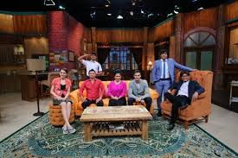
When will we be doing our debates?
5- Thursday, April 13th
4,6- Friday, April 14th

Slide 6
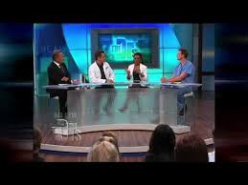
How will we choose our topics?
I will be choosing 4-5 topics that are in the news right now.
All of the topics will be controversial and have many sides to discuss.
You will choose your top 3 choices, and I will do my best to accommodate your 1st or 2nd choice.
I will then assign people to a topic that they will research.

Slide 7
I have my topic, now what??
You will have 1 week to research you topic.
We will do some practicing the next week on “impromptu” topics to get you ready
We will also watch a few talk show examples

Slide 8
When we go to have our debates…
We will draw the topics at random to see what debate order we go in.
You will be prepared to argue both sides, regardless of your opinion.
During the debate, only the host and the debaters will be able to address the issue.
After the time is up, the audience will be able to ask the debate members questions to clarify anything.
Each audience member will then write a short-constructed response on which person gave the best argument and “won” the debate. That side will receive extra credit.

Slide 9
QUESTIONS?

